Slide 1
TOPIC MODELING CASE : NIPS PAPER DATASET
M. DJAMALUDDIN
33218027
Github REPO : https://github.com/mdja/topic_model

Slide 2
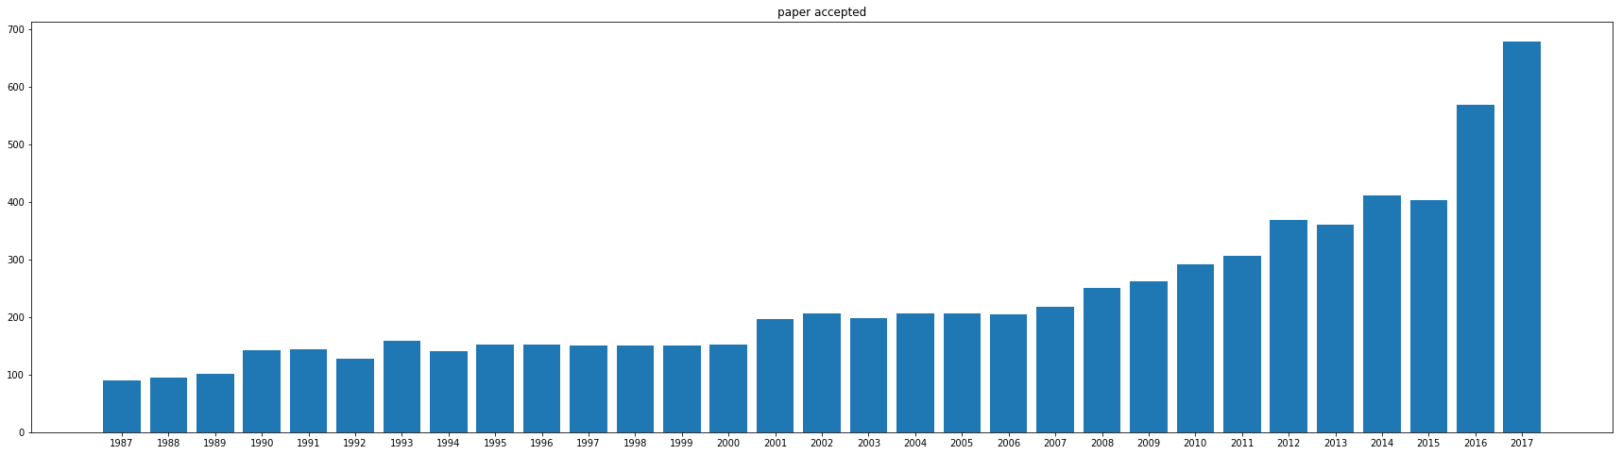
NIPS PAPER DATASET
NIPS : Neural Information Processing Systems, top machine learning conference. https://nips.cc/
Dataset : https://www.kaggle.com/benhamner/nips-papers, data paper available from 1987 – 2017

Slide 3
TOPIC MODELING
Statistical modeling for discovering the abstract “topics” that occur in a collection of documents
Methods :
LSA (Latent Semantic Analysis)
PLSA (Probability Latent Semantic Analysis)
NMF (non Negative Matrix Factorization)
LDA (Latent Dirichlet Allocation)

Slide 4
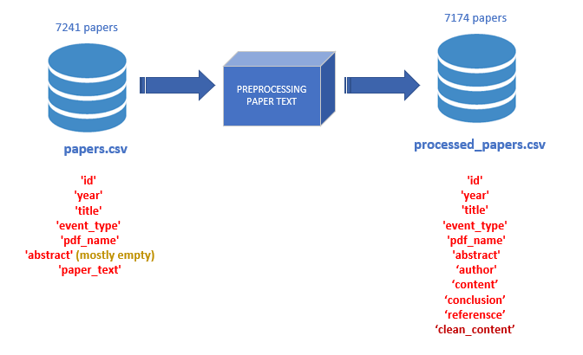
DATASET PREPROCESSING
Pre-processing :
Split paper_text into (abstract, author, content, conclusion, reference)
Use: Regex pattern,
- (1|1.)*\s*INTRODUCTION
- \w*(1.)*[A|AN|THE]*\s[A-Z]{2}\w*[A-Z]\w*
- '[\\n]+(1|1.)[\\n]+
+ Eliminate stop words
+ remove digits
+ remove len(words) < 3
+ replace(‘\n’,’ ‘)
+ lower case
+ Lemmatization

Slide 5
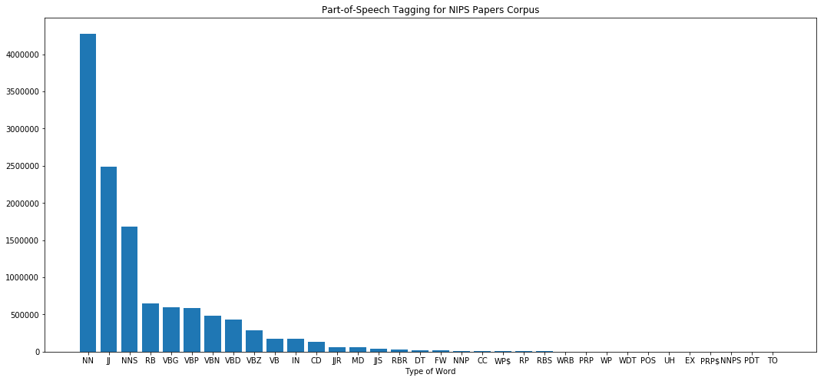
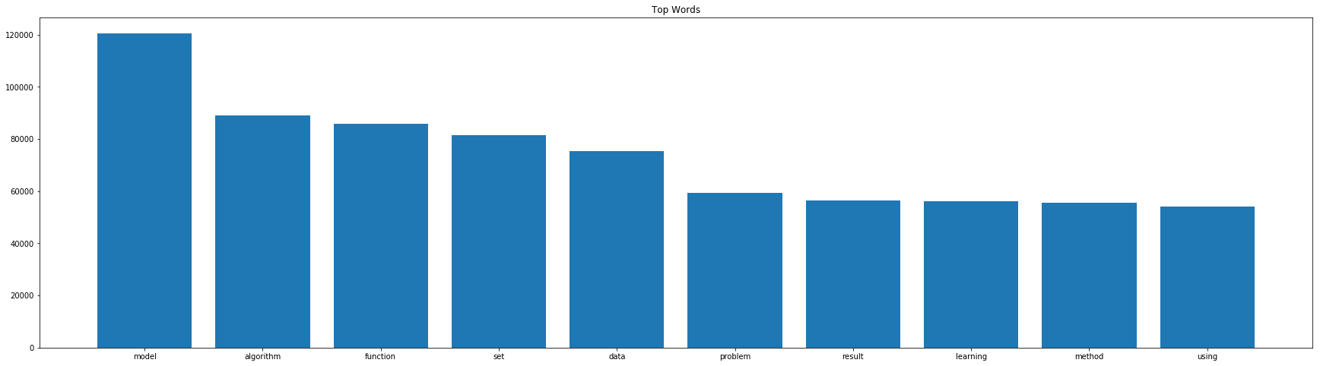
POS Tag in NIPS paper
10 Top Word Used

Slide 6
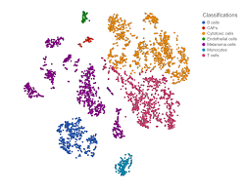
T-SNE (T-DISTRIBUTED STOCHASTIC NEIGBOURING ENTITIES)
sklearn.manifold.TSNE
T-SNE : technique for dimensionality reduction and is particularly well suited for the visualization of high-dimensional datasets
“t-Distributed stochastic neighbor embedding (t-SNE) minimizes the divergence between two distributions: a distribution that measures pairwise similarities of the input objects and a distribution that measures pairwise similarities of the corresponding low-dimensional points in the embedding” (Van der Maaten, 2008)
High dimensional matrix
Plot 2-D by keeping
the similarity vector

Slide 7
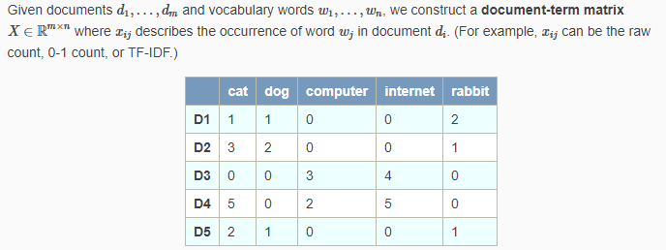

TOPIC MODELING
LSA
The latent in Latent Semantic Analysis (LSA) means latent topics. LSA finds low-dimension representation of documents and words.
Decompose Matrix X into 3 component using SVD
sklearn.decomposition.TruncatedSVD

Slide 8
LSA : Found 18 topics
Topic 0: model algorithm function data network set matrix image distribution learning problem method training feature error kernel result bound using parameter time number sample vector log point input probability value figure
Topic 1: neuron cell network spike input stimulus synaptic response activity circuit model layer firing chip pattern unit synapsis connection visual figure excitatory output inhibitory neural motion frequency time signal voltage synapse
Topic 2: policy reward action agent state mdp function algorithm value regret learning optimal trajectory transition time problem model environment reinforcement mdps bound probability planning expert episode set step decision exploration distribution
Topic 3: spike neuron firing synaptic postsynaptic stdp spiking presynaptic rate synapse membrane input time synapsis train potential weight network model signal circuit function rule learning voltage timing poisson dynamic dendritic threshold
Topic 4: spike stimulus model neuron distribution poisson population correlation response filter data renewal gqm glm count copula cascaded fig plds synchrony fit recording waveform time bin cell train spiking parameter posterior
Topic 5: kernel image face feature shape descriptor inn space signal facial cpd database recipe suppressive pca recognition spike subspace grassmann svm linear eigenface svms function similarity basis universal definite pixel stimulus
….
Top 3 words topic:
Topic 0: model algorithm function
Topic 1: neuron cell network
Topic 2: policy reward action
Topic 3: spike neuron firing
Topic 4: spike stimulus model
Topic 5: kernel image face
Topic 6: node graph edge
Topic 7: kernel graph vertex
Topic 8: kernel tree node
Topic 9: blur image blurring
Topic 10: arm regret bandit
Topic 11: cluster clustering algorithm
Topic 12: tensor rank decomposition
Topic 13: topic document word
Topic 14: circuit voltage chip
Topic 15: cell stimulus response
Topic 16: tree suffix string
Topic 17: manifold ranking geodesic
Topic 18: game player equilibrium

Slide 9
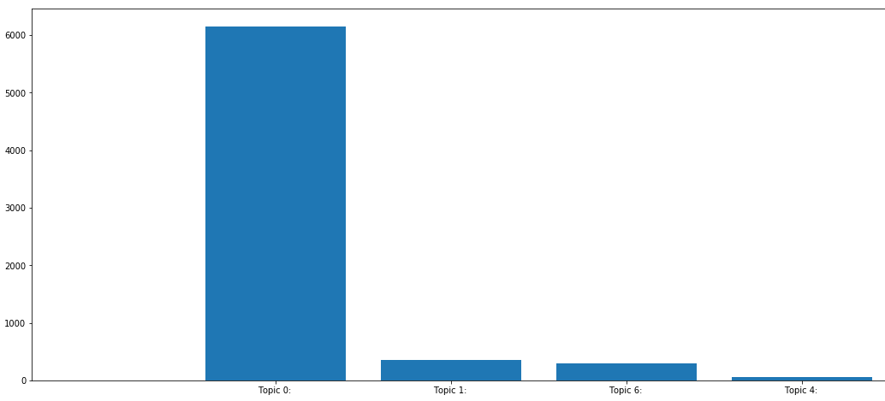
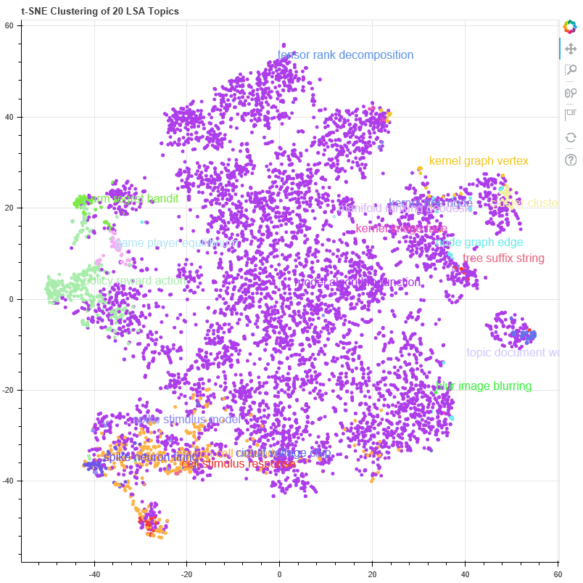
Majority topics Topic 3 : model algorithm function data network set matrix image distribution learning problem method training feature error kernel result bound using parameter time number sample vector log point input probability value figure
#paper : 6157

Slide 10
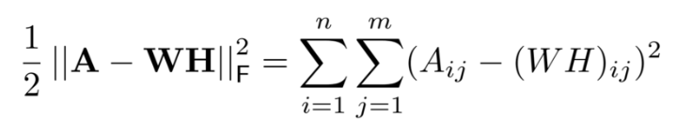
NMF
Factors high-dimensional vectors into a low-dimensionality representation. Similar to Principal component analysis (PCA), NMF takes advantage of the fact that the vectors are non-negative. By factoring them into the lower-dimensional form, NMF forces the coefficients to also be non-negative.
Given A = Document Matrix, Find W, H such that A = WH. Where
W = Basic Vector – topic discovered from documents
H = Coefficient Matrix – membership weight for topics in each doc
Obejctive Function :
sklearn.decomposition.NMF

Slide 11
NMF : Found 20 topics
Topic 0: algorithm matrix problem method gradient convex function convergence solution set iteration optimization data lasso vector point sparse objective theorem norm rate result update dual log min step descent let stochastic
Topic 1: neuron spike firing synaptic model network input time activity rate stimulus spiking synapsis membrane dynamic pattern postsynaptic response neural signal potential train function fig rule learning correlation weight distribution state
Topic 2: policy reward state action function mdp algorithm value trajectory optimal transition problem learning controller gradient time cost mdps model iteration agent set bellman bound control reinforcement method distribution probability using
Topic 3: image object model feature pixel patch layer training scene set face network shape data segmentation method using figure representation visual detection result map filter algorithm color region two learning recognition
Topic 4: network unit layer input weight training hidden output learning function neural model error set pattern net activation one architecture data neuron time number wa node figure state result vector algorithm
Topic 5: model distribution data posterior gaussian parameter variational function prior inference latent sample variable likelihood log method set algorithm mixture bayesian matrix using density covariance sampling process probability approximation number estimate
Topic 6: regret arm bandit algorithm bound reward round action log loss online problem function setting ucb time theorem set learner buyer policy let lemma strategy convex optimal expert exploration proof distribution
Topic 7: graph edge vertex node algorithm model set matrix variable problem function network cut method bound theorem data one log result dag structure number distribution let path random constraint probability graphical
….
Top 3 words topic:
Topic 0: algorithm matrix problem
Topic 1: neuron spike firing
Topic 2: policy reward state
Topic 3: image object model
Topic 4: network unit layer
Topic 5: model distribution data
Topic 6: regret arm bandit
Topic 7: graph edge vertex
Topic 8: classifier label training
Topic 9: kernel function matrix
Topic 10: topic document word
Topic 11: cell stimulus response
Topic 12: cluster clustering algorithm
Topic 13: game player equilibrium
Topic 14: bound function loss
Topic 15: circuit chip voltage
Topic 16: tensor matrix rank
Topic 17: node tree algorithm
Topic 18: signal model speech
Topic 19: agent action reward

Slide 12
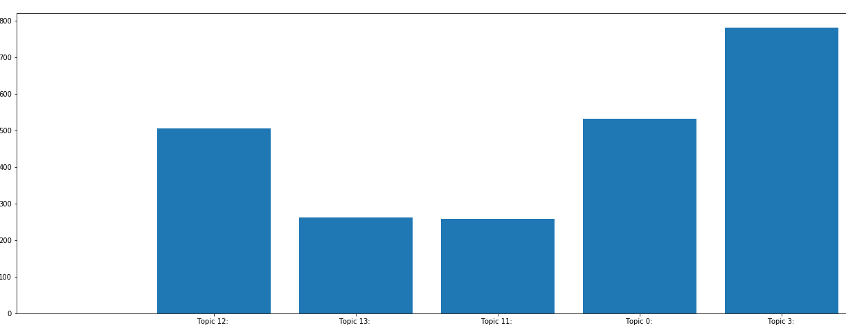
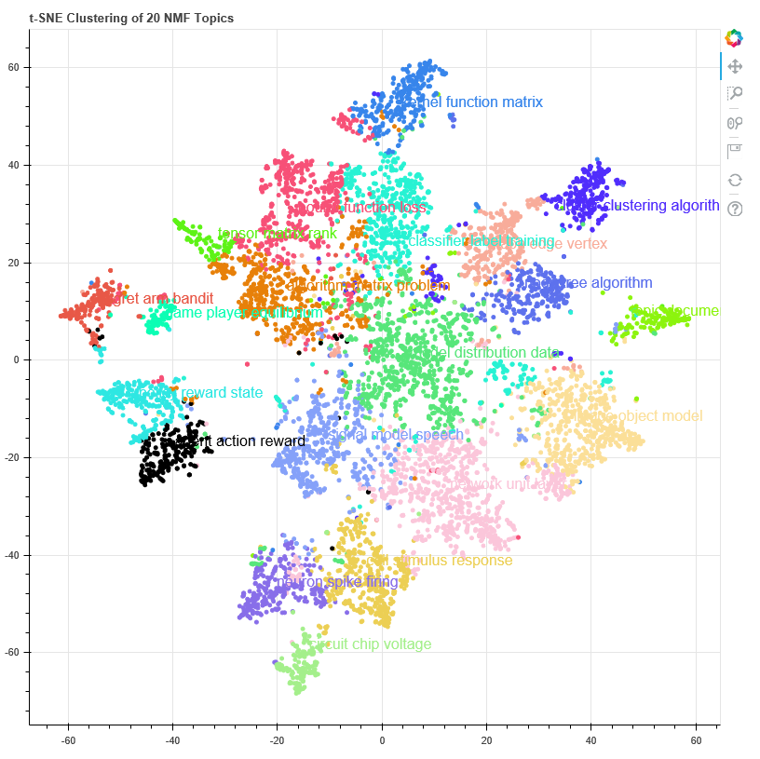
Majority topics
Topic 3 : image model pixel patch feature face object training network set color data layer using shape scene result method filter figure segmentation texture visual region algorithm distribution pose representation used one
#paper : 782

Slide 13
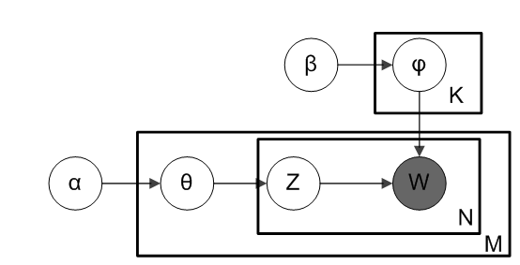
LDA
LDA is an unsupervised learning methods that views documents as bags of words. LDA works by first making a key assumption: the way a document was generated was by picking a set of topics and then for each topic picking a set of words.
From plate diagram of an LDA model : α is the per-document topic distributions, β is the per-topic word distribution, θ is the topic distribution for document m, φ is the word distribution for topic k, z is the topic for the n-th word in document m, and w is the specific word
sklearn.decomposition.LatentDirichletAllocation

Slide 14
LDA : Found 20 topics
Top 3 words topic:
Topic 0: state algorithm policy
Topic 1: neuron spike model
Topic 2: model word set
Topic 3: model distribution data
Topic 4: network input neuron
Topic 5: data model time
Topic 6: game player strategy
Topic 7: note motif chorale
Topic 8: algorithm function bound
Topic 9: algorithm function network
Topic 10: search query algorithm
Topic 11: model learning figure
Topic 12: user item rating
Topic 13: model signal frequency
Topic 14: image model object
Topic 15: data set algorithm
Topic 16: protein structure contact
Topic 17: image model network
Topic 18: matrix algorithm model
Topic 19: model learning control
Topic 0: state algorithm policy function model set value node time action problem graph reward variable number learning agent using result probability distribution given ha method tree figure network optimal case parameter
Topic 1: neuron spike model time stimulus rate input response information function firing figure distribution noise neural data learning train wa state parameter population using different cell network correlation signal value mean
Topic 2: model word set data training network using used sequence topic number feature result vector input state learning probability distribution wa time parameter figure document algorithm use ha method function task
Topic 3: model distribution data function parameter set using method algorithm variable posterior sample prior time gaussian number log given inference process figure used result probability network learning mean use value ha
Topic 4: network input neuron model time figure output unit function cell pattern weight learning circuit state neural value wa ha activity connection current set result layer signal synaptic number response used
…

Slide 15
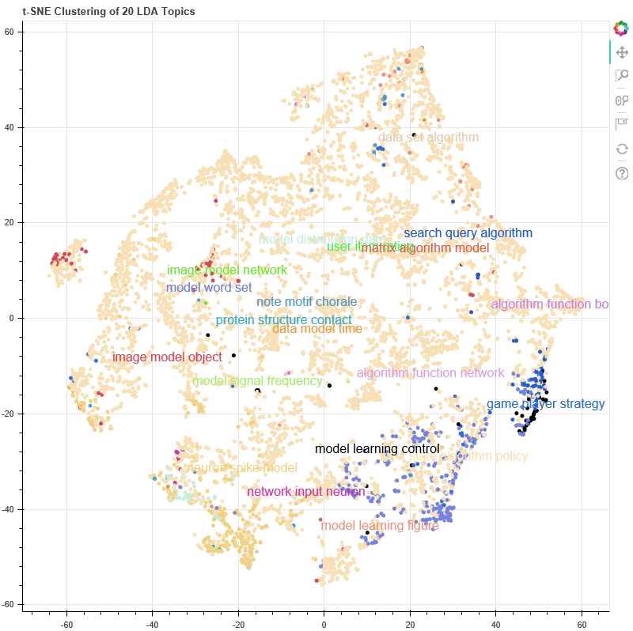
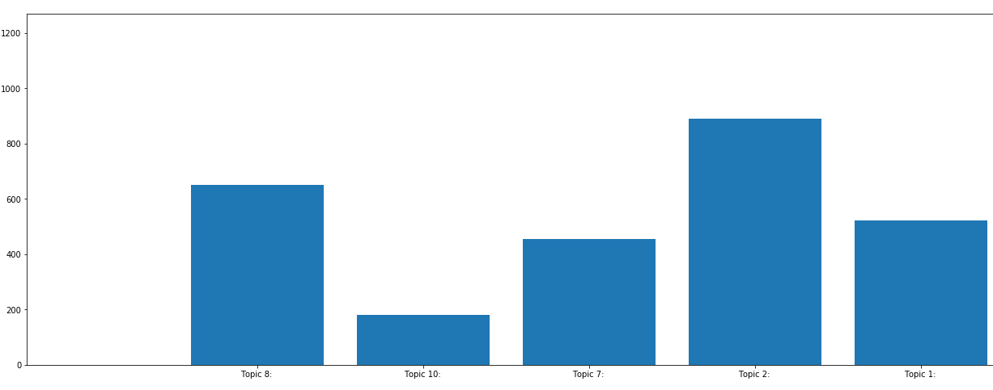
Majority topics
Topic 3 : image model pixel patch feature face object training network set color data layer using shape scene result method filter figure segmentation texture visual region algorithm distribution pose representation used one
#paper : 782

Slide 16
ANALYSIS MODEL
LDA is a probability model. Measurement :
Log likelihood : how sensitive likelihood of event, higher is better
Perplexity :
perplexity is a measurement of how well a probability distribution or probability model predicts a sample. A low perplexity indicates the probability distribution is good at predicting the sample.
Perplexity is defined as exp(-1. * log-likelihood per word)
Use GridSearch to find the best parameter of LDA (n_topic, learning_decay)

Slide 17
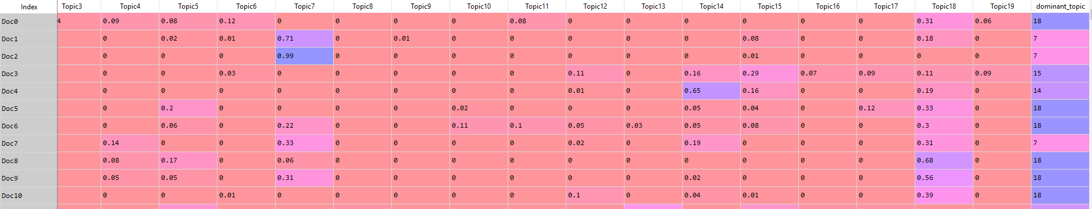
Best Model's Params: {'learning_decay': 0.9, 'n_components': 20}
Best Log Likelihood Score: -26885032.144534886
Model Perplexity: 1372.1462420943
Dominant Topic per document :

Slide 18
Topic Coherence
Topic Coherence is a measure used to evaluate topic models
topic coherence is applied to the top N words from the topic. It is defined as the average / median of the pairwise word-similarity scores of the words in the topic
A good model will generate coherent topics, i.e., topics with high topic coherence scores. Good topics are topics that can be described by a short label, therefore this is what the topic coherence measure should capture.
Topics coherence LSA values = -1.936255302421058
Topics coherence NMF values = -0.8832852958216879
Topics coherence LDA values = -0.7863112062812903

